Slide 1
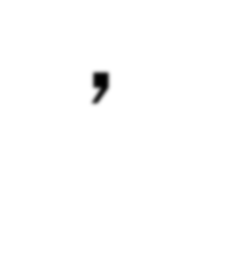

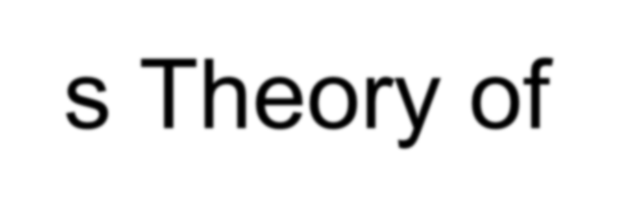



Slide 2
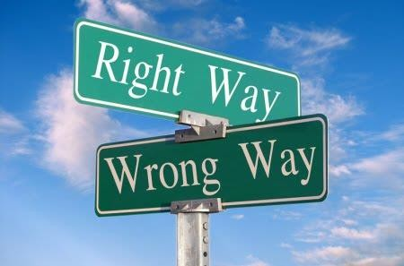
Moral Development
Moral development is the gradual development of an individuals concept of right or wrong – conscious, religious values, social attitudes and certain behaviour.

Slide 3
Kohlberg's Theory
This theory is a stage theory. In other words, everyone goes through
the stages sequentially without skipping any stage.
However, movement through these stages are not natural, that is people do not automatically move from one stage to the next as they mature. In stage development, movement occurs when a person notices inadequacies in his or her present way of coping with a given moral dilemma.
According to stage theory, people cannot understand moral reasoning more than one stage ahead of their own. For example, a person in Stage 1 can understand Stage 2 reasoning but nothing beyond that.

Slide 4


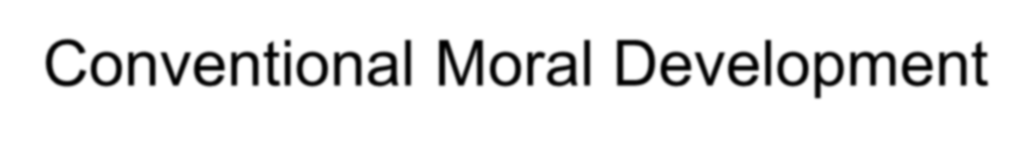
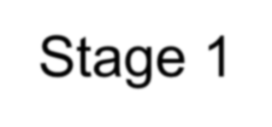

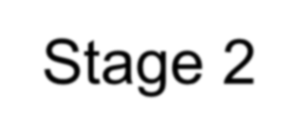
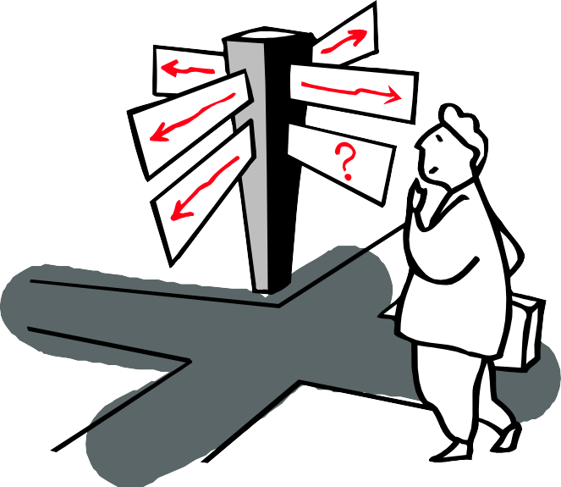
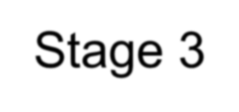
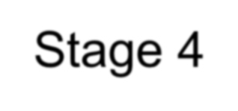

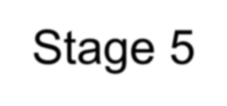
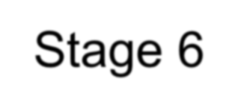
Kohlberg’s Six Stages

Slide 5
Level 1: Preconventional Morality 0-9 years
Stage 1 - Obedience and Punishment
Especially common in young children, but adults are capable of expressing this type of reasoning. At this stage, children see rules as fixed and absolute.
Obeys rules in order to avoid punishment
Determines a sense of right and wrong by what is punished and what is not punished
Obeys superior authority and allows that authority to make the rules, especially if that authority has the power to inflict pain.
​Is responsive to rules that will affect his/her physical well-being

Slide 6
Stage 2 – Naively egotistical
At this stage of moral development, children account for individual points of view and judge actions based on how they serve individual needs. Reciprocity is possible, but only if it serves one's own interests.
Is motivated by vengeance or “an eye for an eye” philosophy
Is self-absorbed while assuming that he/she is generous
Believes in equal sharing in that everyone gets the same, regardless of need
Believes that the end justifies the means
Will do a favor only to get a favor
Expects to be rewarded for every non-selfish deed he/she does

Slide 7
Level 2: Conventional Morality 10-15 years
Stage 3 - "good boy-good girl" orientation,
This stage of moral development is focused on living up to social expectations and roles. There is an emphasis on conformity, being "nice," and consideration of how choices influence relationships.
Finds peer approval very important
Feels that intensions are as important as deeds and expects others to accept intentions or promises in place of deeds
Begins to put himself/herself in another’s shoes and think from another perspective

Slide 8
Level 2
Stage 4 – Law and Social Order
At this stage of moral development, people begin to consider society as a whole when making judgments. The focus is on maintaining law and order by following the rules, doing one’s duty, and respecting authority.
Is a duty doer who believes in rigid rules that should not be changed
Respects authority and obeys it without question
Supports the rights of the majority without concern for those in the minority
Is part of about 80% of the population that does not progress past stage 4

Slide 9
Level 3: Postconventional Morality – 16+
Stage 5 - Legalistic Social Contract
At this stage, people begin to account for the differing values, opinions, and beliefs of other people. Rules of law are important for maintaining a society, but members of the society should agree upon these standards.
Is motivated by the belief in the greatest amount of good for the greatest number of people
Believes in consensus (everyone agrees), rather than in majority rule
Respects the rights of the minority especially the rights of the individual
Believes that change in the law is possible but only through the system

Slide 10
Stage 6 – Universal ethical Principles
Kolhberg’s final level of moral reasoning is based upon universal ethical principles and abstract reasoning. At this stage, people follow these internalized principles of justice, even if they conflict with laws and rules.
​Believes that there are high moral principles than those represented by social rules and customs
Is willing to accept the consequences for disobedience of the social rule he/she has rejected
​Believes that the dignity of humanity is sacred and that all humans have value

Slide 11
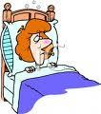


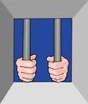
The Heinz Dilemma:
A woman was near death from a special kind of cancer. There was one drug that the doctors thought might save her. It was a form of radium that a druggist in the same town had recently discovered. The drug was expensive to make, but the druggist was charging ten times what the drug cost him to produce. He paid $200 for the radium and charged $2,000 for a small dose of the drug. The sick woman's husband, Heinz, went to everyone he knew to borrow the money, but he could only get together about $1,000 which is half of what it cost. He told the druggist that his wife was dying and asked him to sell it cheaper or let him pay later. But the druggist said: "No, I discovered the drug and I'm going to make money from it." So Heinz got desperate and broke into the man's store to steal the drug for his wife.

Slide 12

What would you do?

Slide 13
Criticisms of Kohlberg's Theory of Moral Development: Criticism
Does moral reasoning necessarily lead to moral behavior? Kohlberg's theory is concerned with moral thinking, but there is a big difference between knowing what we ought to do versus our actual actions.
Is justice the only aspect of moral reasoning we should consider? Critics have pointed out that Kohlberg's theory of moral development overemphasizes the concept as justice when making moral choices. Other factors such as compassion, caring, and other interpersonal feelings may play an important part in moral reasoning.
Does Kohlberg's theory overemphasize Western philosophy? Individualistic cultures emphasize personal rights while collectivist cultures stress the importance of society and community. Eastern cultures may have different moral outlooks that Kohlberg's theory does not account for.

Slide 14
LEARNING ACTIVITY
For the following moral dilemma, describe a response which might be given by someone in each of the first four stages of Kohlberg's theory.
Jill goes shopping one day with her best friend, Sujatha. Sujatha tries on a jumper and walks out of the shop wearing it under her jacket. Jill is left to face the store's security person who insists that Jill names Sujatha and gives Sujatha's address. The manager of the store tells Jill she will be in serious trouble if she does not disclose Sujatha's name and address. What should Jill do?

Slide 15
Question: Is it harder to be ethical today than 50 years ago?

Slide 16
Ethics must adapt to new global and organizational realities
Why Environment is Changing
Globalization
Technology & Digitalization
Environmental Sustainability
Social Awareness & Activity

Slide 17
Globalization
Different cultures & legal systems → ethical conflicts
Example: product banned in one country but sold in another
Technology
Data privacy, AI bias, surveillance challenges
Example: Cambridge Analytical data misuse

Slide 18
Environmental Sustainability
Climate change & resource depletion
CSR demands businesses act responsibly
Example: Oil & gas industry pressure
Social Awareness & Activism
Consumers demand ethical practices: fair trade, cruelty-free, transparency
Example: The Body Shop human rights advocacy

Slide 19
Case Study: The National Conductor – Was He Morally Responsible?

Slide 20
Background
A national railway system was under pressure to improve efficiency and reduce delays. Conductors and staff were instructed to prioritize punctuality, as the public image of the railway was suffering.
One evening, a conductor prepared to depart a busy intercity train. During the final safety checks, a junior staff member flagged a possible brake fault in one of the compartments. According to protocol, the train could still be dispatched if the defect was not confirmed as critical by the technical team. However, calling in technical staff would delay the train by at least 45 minutes.

Slide 21
The Incident
The conductor faced pressure:
Management Pressure: The station supervisor reminded him that late departures would trigger penalties for the team.
Passenger Pressure: Hundreds of commuters were growing restless, demanding an immediate departure.
Personal Pressure: The conductor’s performance review (and bonus) depended on punctuality.
He made the decision to proceed with departure, reasoning that the defect was likely minor.
Halfway through the journey, the suspected brake fault caused a serious malfunction, leading to a derailment.
Several passengers were injured, and two fatalities occurred.
Investigations revealed the conductor had technically followed company policy, but he also had the authority to delay the train in the interest of safety.

Slide 22
The Ethical Dilemma
Legally: He followed the railway company’s minimum requirements.
Ethically: Did he fail in his duty of care to passengers?

Slide 23
Applying Ethical Theories
Deontology (Duty-based):
Duty to protect lives must override schedules.
By not delaying, he failed his moral duty despite following rules.
Utilitarianism (Consequences):
The harm (injuries, deaths) far outweighed the benefit (avoiding a 45-minute delay).
From a utilitarian view, his choice was unethical.
Virtue Ethics (Character-based):
Courage, integrity, and prudence should guide professional behavior.
A virtuous conductor would have delayed the train, despite pressure.

Slide 24
Discussion Questions
Was the conductor morally responsible, even if he was not solely legally liable?
Should professionals act beyond company policy when ethical alarms go off?
To what extent should external pressures (deadlines, passenger complaints, performance reviews) excuse ethical lapses?

